Slide 1
SENTIMENT ANALYSIS
Presented By : Ishita Chakraborty
Advanced Natural Language Processing
Oct 30th 2018

Slide 2

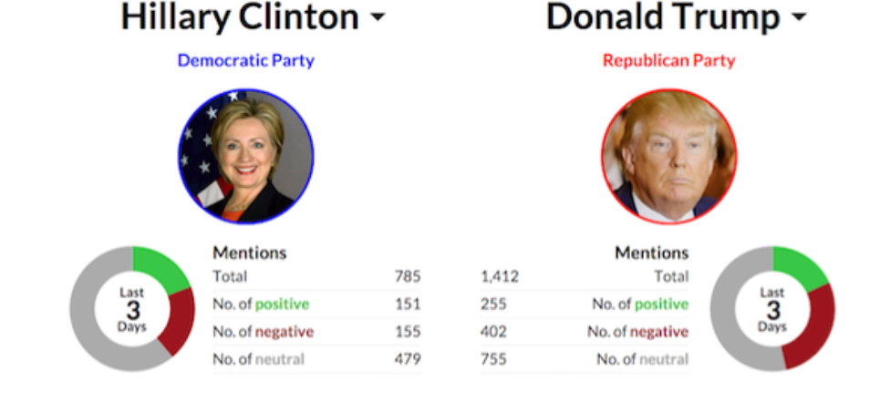
Why this topic?
One of the NLP research areas that has found widespread interest in areas outside CS and Linguistics – politics, business and social sciences
http://freshtakeoncontent.com/use-social-media-to-listen-to-your-customers/
https://www.washingtonpost.com/graphics/politics/2016-election/the-demographic-groups-fueling-the-election/?noredirect=on
Notes:
-Social Listening involves listening not only to the focal customer but to other members in his network- friends , acquaintances. There are millions of consumer conversations that happen every minute on Twitter, Snapchat, Instagram, Facebook and marketers care about being updated with them.
-
-There were other ways to listen to customers- surveys , focus groups but studying online reactions is a cheaper way to be updated of changing customer reactions and expectations
-Also this is the only method that provides almost real-time, instantaneous reactions and comments

Slide 3
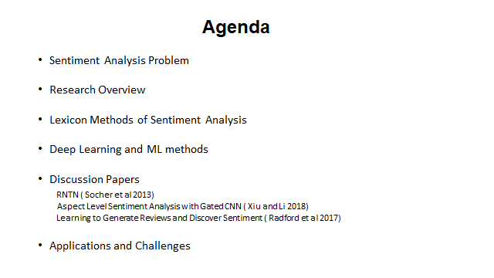

Slide 4
Sentiment Analysis Problem
The restaurant was a pleasant experience. The food was extremely delicious but I wish the service could be better. The waiting staff was plain rude. Cleanliness was up to expectations but the price was a rip-off
The Sentiment Analysis problem is to extract:
Sentiment - Good , Bad or Neutral
Extent – Fine –grained sentiment analysis
Target – Who is the target of the sentiment?
When & Who- When and who expressed this opinion?
Notes:
Very impressive progress in the area of binary sentiment analysis ( SOTA 92 %)
Good progress in the area of fine-grained sentiment analysis especially after neural networks became popular ( SOTA 53 %)
Still some challenges in target-based fine-grained sentiment analysis
Not much focus on “ whose” opinion it is and this is an interesting problem that I will revisit

Slide 5


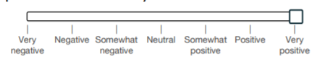
Sentiment Analysis Problem: Difficulty levels
Simple Task : Positive or Negative
Somewhat complex : How positive or how negative?
Complex Task : Who is the target of the sentiment?

Slide 6
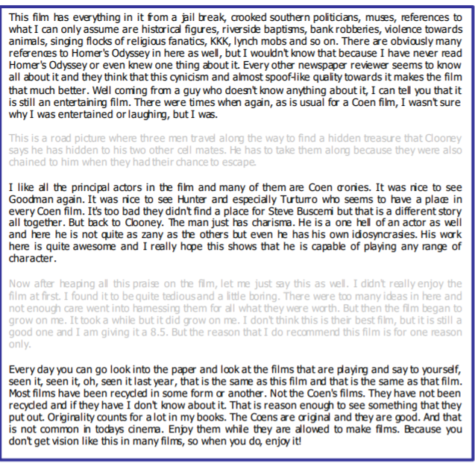
Sentiment Analysis Problem: Analysis Unit
Document-Level
Sentence-Level
Aspect Level
The food at that restaurant tasted very bad
The food at that restaurant tasted very bad
However service was impeccable
The movie was the worst experience ever!!!!!
Notes:
Andrew L. Maas, Raymond E. Daly, Peter T. Pham, Dan Huang, Andrew Y. Ng, and Christopher Potts. 2011. Learning word vectors for sentiment analysis. In Proceedings of ACL:HLT, 142-150.

Slide 7
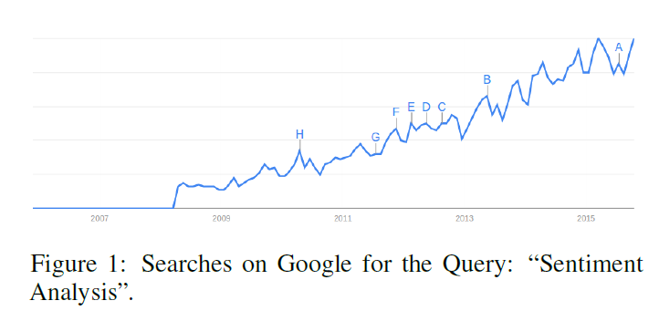
SENTIMENT ANALYSIS RESEARCH
Remains an active area of research
Early Dictionary methods are simple and interpretable but lack flexibility and require significant human effort
Deep neural networks improved accuracy but lack interpretability
Simplicity, Interpretability
Dictionary/ Lexicon Methods
Machine Learning
Vector Space Methods (VSM)
(2011-2018)
1970’s onwards
Deep Neural Networks like RNN
Flexibility
Notes:
Sources :
( to be added)

Slide 8
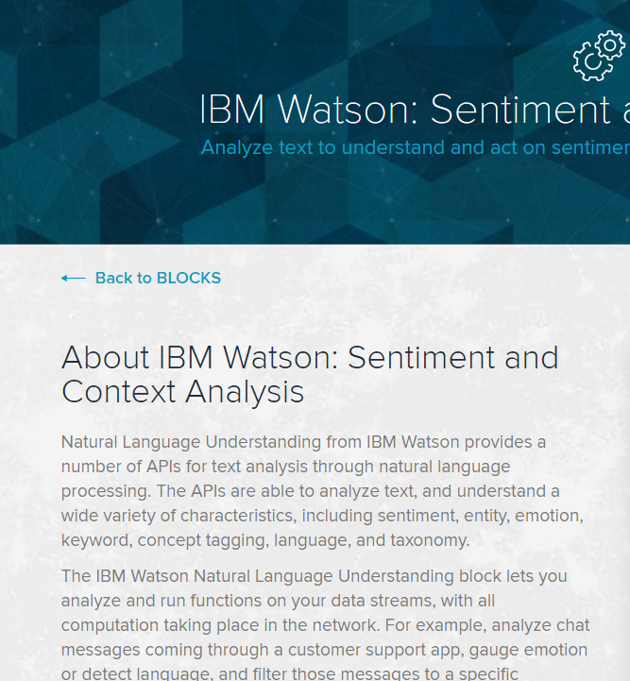
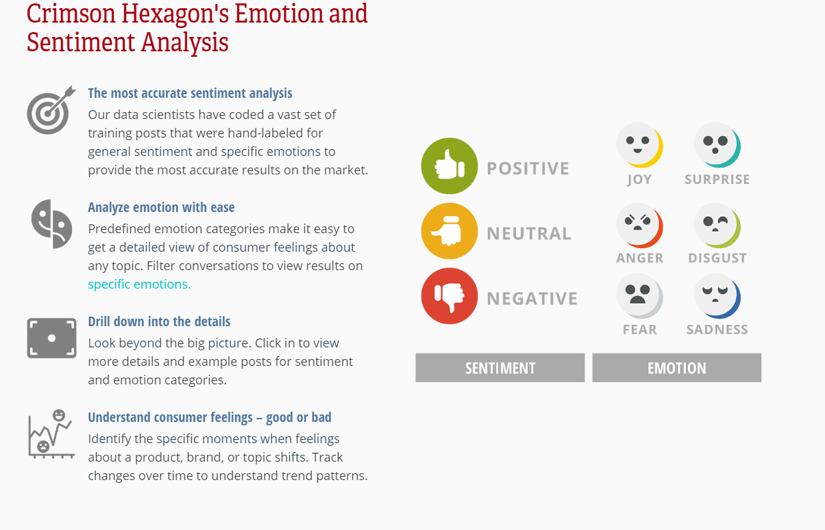
Commercial Sentiment Analysis Software
Notes:
Various commercial tools have sprung up with different degrees of success
Mixed user experiences when using these tools and lot if improvement scope. Tools are still not very good at getting negation or polysemy right

Slide 9
Dictionary Based Methods

Slide 10
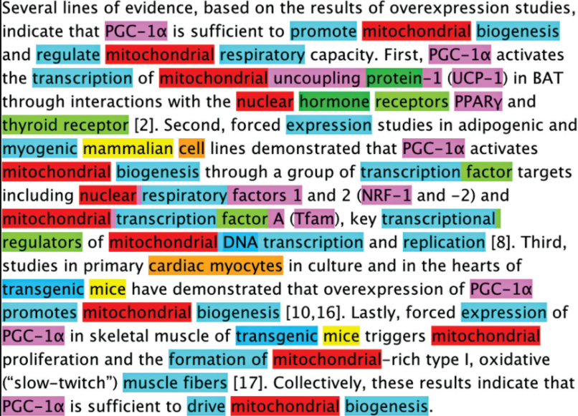
Lexicon Methods : Framework
Input corpus
POS tagging- Identify common noun and noun phrases, adjectives and adverbs
Perform search over a pre defined lexicon or dictionary
Assign a sentiment class to every opinion word
Do some form of opinion aggregation to assign a single sentiment class to the whole document
Dictionary
Word | sentiment
Good | +1
Great | +2
bad | -1
Notes:
Many lexicons were created for these tasks :
LIWC
SentiNet
Some lexicons work better on certain datasets and there is no widespread method comparison across datasets

Slide 11
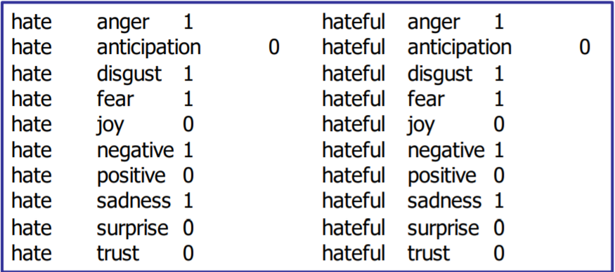
Static Human Tagged Lexicons
Hu and Liu (2004) lexicon contains 2006 positive words and 4783 negative words
Mohammad and Turney (2013) Lexicon contains 14182 words with 10 labels (8 emoticons and 2 sentiments)
Saif M. Mohammad and Peter D. Turney. 2010. Emotions evoked by common words and phrases: using mechanical turk to create an emotion lexicon. In Proceedings of NAACL:HLT 2010 Workshop on CAAGET, 26-34.
Notes:
Many lexicons were created for these tasks :
LIWC
SentiNet
Some lexicons work better on certain datasets and there is no widespread method comparison across datasets

Slide 12
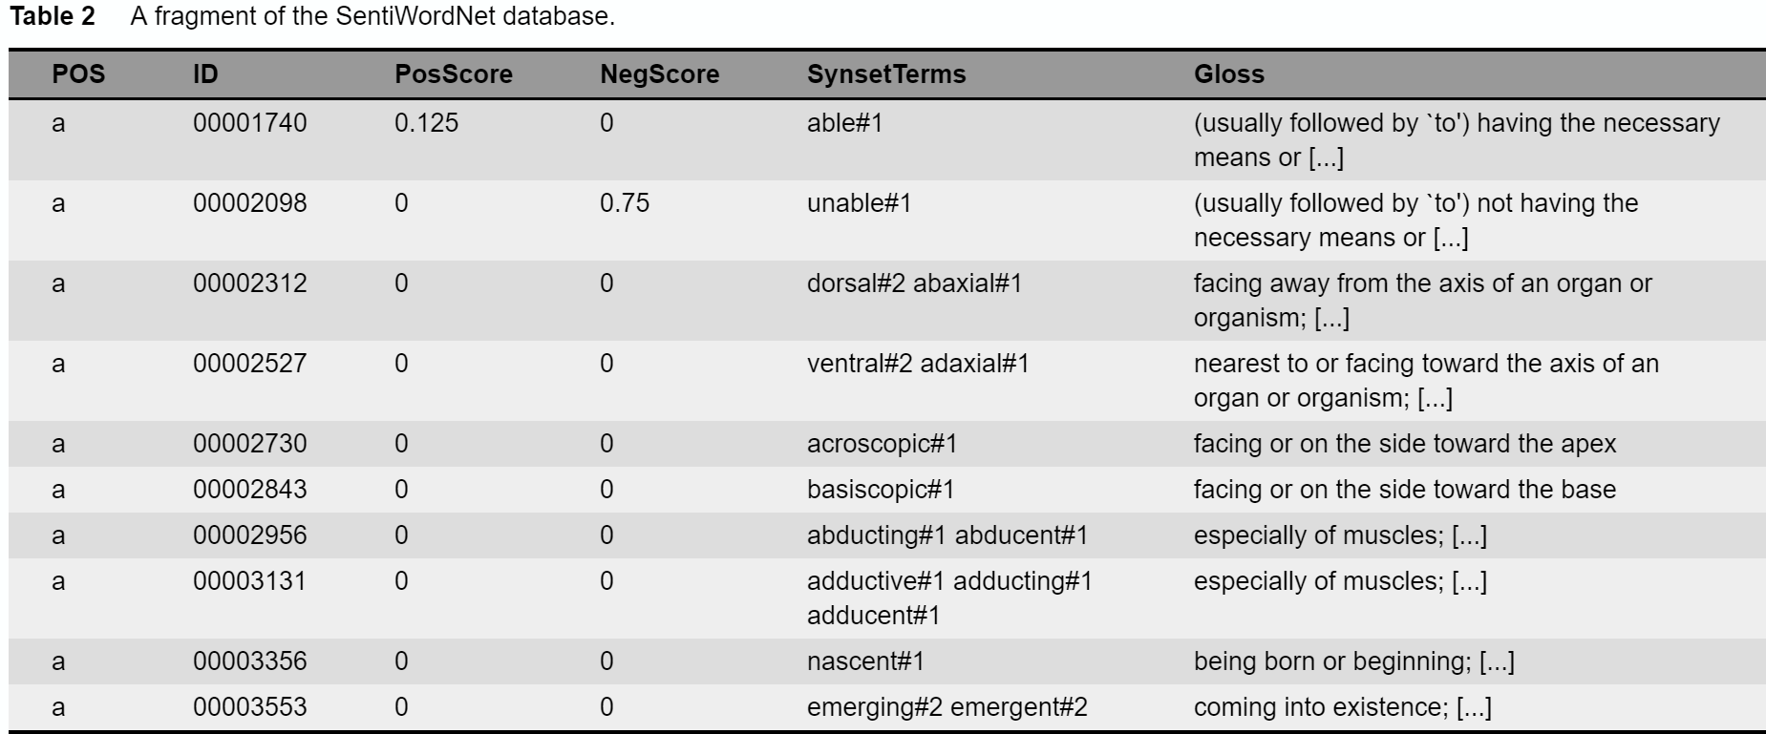
Automation: SentiNet Project
SentiWordNet (Esuli et al, 2006) learns positive and negative sentiment scores for synsets in WordNet
Source : http://sentiment.christopherpotts.net/lexicons.html#sentiwordnet
Notes:
Many lexicons were created for these tasks :
LIWC
SentiNet
Some lexicons work better on certain datasets and there is no widespread method comparison across datasets

Slide 13
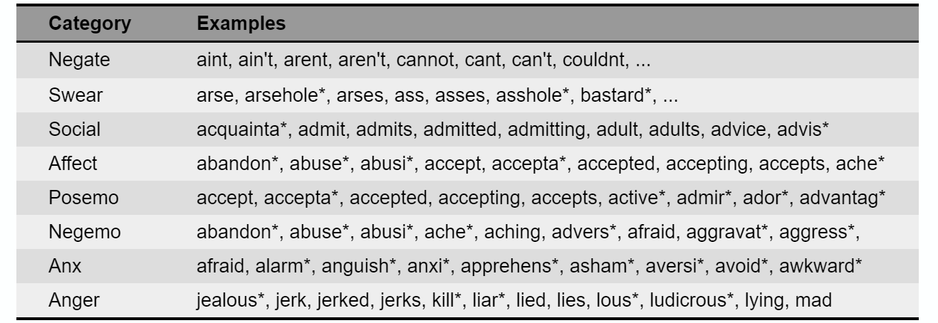
LIWC
Linguistic Inquiry and Word Counts (LIWC) is a propriety database consisting of a lot of categorized regular expressions
Source : http://sentiment.christopherpotts.net/lexicons.html#sentiwordnet
Notes:
Many lexicons were created for these tasks :
LIWC
SentiNet
Some lexicons work better on certain datasets and there is no widespread method comparison across datasets

Slide 14
Dictionary Methods : Success and Failures
Worked extremely well for opinion summarization of large documents
Have been used for opinion trend analysis in political blogs and opinion summarization on forums like TripAdvisor
Several lexicons and open databases were created to improve scalability of these methods
Not scalable method, lexicon used in one domain has little applicability in a different domain
Fail to accurately capturing negation or sentiment shifters - “ not the greatest movie ” , “ pretty bad ”
Fail to do well for small texts like tweets
Human effort is large
https://wordnet.princeton.edu/

Slide 15
Negation : Hard to handle
Negation impacts the polarity of the base word in many complicated ways
“ not good ” -----------→ Total Reversal
“ not that great ” --------→ Partial Reversal
“ not so much of a success ” ---------→ Changes degree
“ good but hard to get ” ---------→ Contrastive Conjunction
Lexicon methods in general have not done very well in handling negative and some deep learning models ( Socher et al 2013 , Kim 2014 ) have shown better results in handling negation

Slide 16
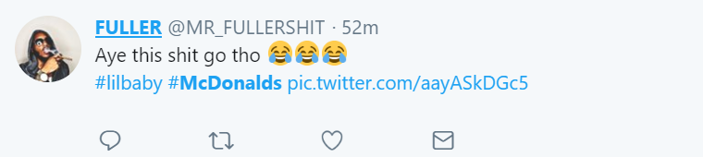
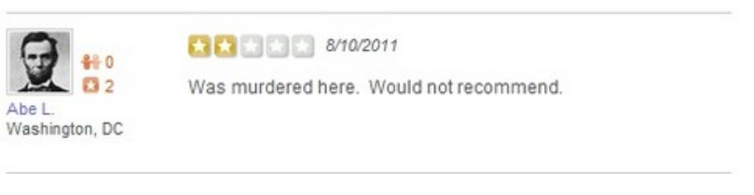
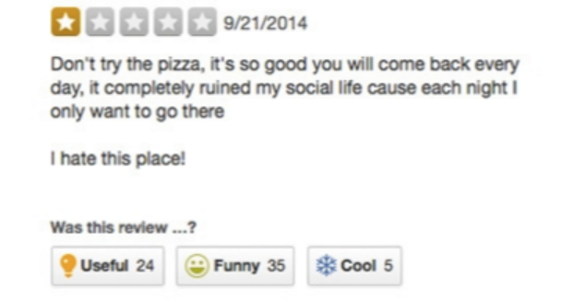
Specific challenges for social media text
Informal , Vocabulary varies
Sarcasm and Humor
Spelling Mistakes ( Deliberate)
e.g. Amaaaziiing , suuuuuuperrrr !!!!
Emoticons , hashtags , special strings
Fake reviewers
Meta-information like links and dates
Notes:
Good means good but gooooooooood might mean very good. So some of these intentional spelling mistakes might be linked to extent of sentiment

Slide 17
Challenges in creating lexicons
Even Humans are not 100 percent accurate in classifying sentiments , the task becomes harder when we go beyond the 3- classes
One way to overcome this challenge is to use Max Diff Technique
Example Max Diff Question :
Which of the 4 words is most positive : good , nice , spectacular , great ?
Possible Answer : nice < good < great < spectacular
Kiritchenko, Zhu, and Mohammad, 2014 generated 3000 Max Diff questions and each question was answered by 10 annotators on CrowdFlower

Slide 18
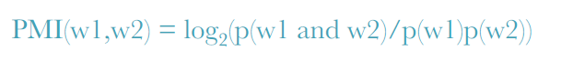
Challenges in creating lexicons
Since it is hard to generate large lexicons, there been techniques that can create similar words from a base word
A measure like Pointwise Mutual Information ( PMI) is used to find how similar words are
Idea is to create some seed positive and negative words and measure the similarity of new words based on these words
High PMI => words likely to co-occur a lot more
Low PMI = > words do not co occur

Slide 19
Comparison Paper 1 : SentiBench
A large scale comparison of 24 state-of-practice lexicon and ML methods of sentiment analysis using 18 datasets across various domains from movie reviews, blogs and Ted talks . All methods classify text into positive and negative ( 2-class ) or positive, negative , neutral ( 3-class)
Main Results:
There is no single method that does equally well on all datasets
There is considerable difference in output when using different methods
Also most methods seem to be better at identifying positive text over negative text
Methods Compared:
LIWC, SentiNet, AFINN , Opinion Lexicon, SO-CAL, Umigon , Sentiment140 , SASA [69] etc.
Comparison Metrics:
Precision , Recall, F1 and Coverage
Notes:
Paper Name : SentiBench - a benchmark comparison of state-of-the-practice sentiment analysis methods
Filipe N Ribeiro, Matheus Ara´ujo, Pollyanna Gonc¸alves , Marcos Andr´e Gonc¸alves , Fabr´ıcio Benevenuto

Slide 20
Deep Learning for Sentiment Analysis

Slide 21
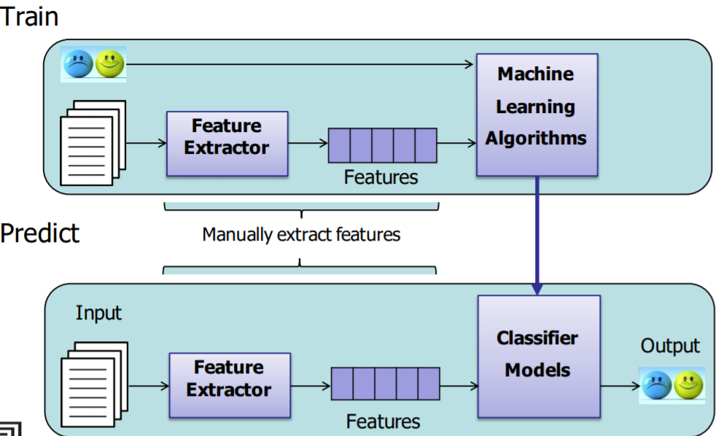
https://www.aclweb.org/mirror/emnlp2016/tutorials/zhang-vo-t4.pdf
Sentiment Analysis : Machine Learning Methods

Slide 22
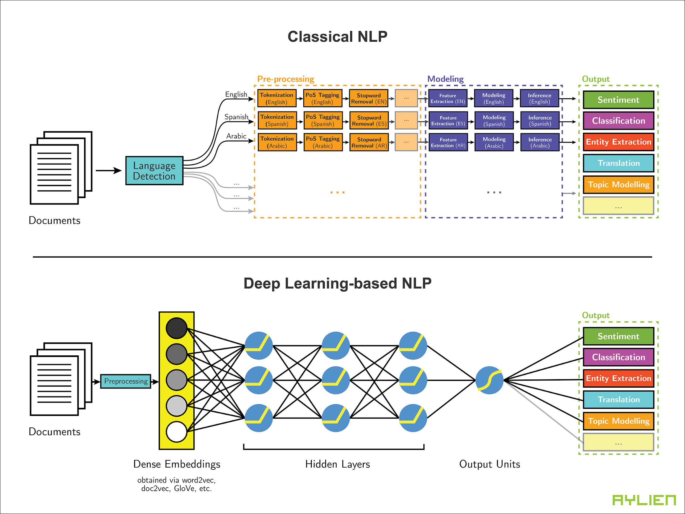
Deep Learning for Sentiment Analysis
Popular word embedding's used are word2vec, GLOVE, ELMO
Different types of networks have been considered for NLP tasks- CNN , RNN, RNTN , LSTM , C-LSTM . Attention-Based
Some papers have also looked at combing Deep learning models with other supervised classifiers like SVM
Specific tasks where DL has achieved good success – fine-grained and aspect level sentiment analysis
Deep learning for Sentiment Analysis : A survey : Zhang et al - https://arxiv.org/ftp/arxiv/papers/1801/1801.07883.pdf
Notes:
I sometimes wonder whether the improvement is more due to word embedding's or neural network architecture

Slide 23
Convolutional Neural Networks ( Kim 2014)
How well can we do with a simple CNN?
Sentence level Neural Network
Single Layer CNN
Varied window size convolutional filters
Multi channel
Notes:
Yoon Kim. 2014. Convolutional neural networks for sentence classification. In Proceedings of EMNLP, 1746-1751.

Slide 24
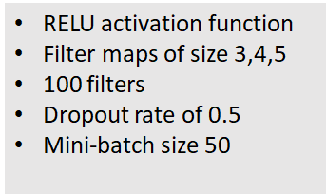
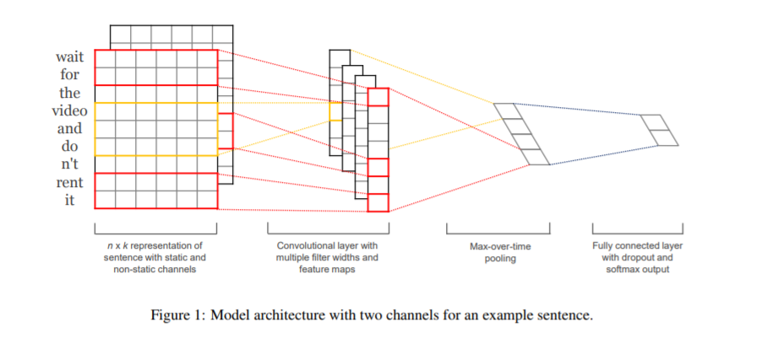
CNN for Text Classification : Architecture
Vanilla CNN for text classification ( Kim 2014)
Notes:
Very simple architecture where the embedding layer is followed by a single convolutional layer and max pooling layer.
This is followed by a softmax classifier
The embedding layer is initialized by GlOVE embeddings and fine-tuned during training

Slide 25
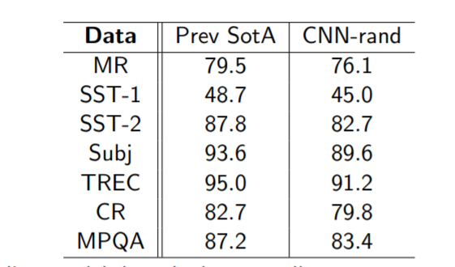
Comparison with Other Models
CNN-rand
CNN –rand is their baseline model that initializes all word vectors randomly
It still performs at par with SOTA for many tasks
Notes:
Yoon Kim. 2014. Convolutional neural networks for sentence classification. In Proceedings of EMNLP, 1746-1751.
SST-1 : Stanford Sentiment Treebank 5 levels
SST -2 : Same as above with neutral removed and only positive/negative
TREC: Question Answer dataset

Slide 26
Comparison with Other Models
CNN-static
CNN –static uses static word vectors from word2vec
Same hyper parameters for all datasets
Notes:
Yoon Kim. 2014. Convolutional neural networks for sentence classification. In Proceedings of EMNLP, 1746-1751.

Slide 27
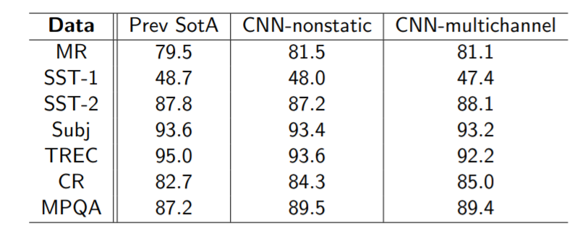
Comparison with Other Models
CNN- multichannel
CNN –multi channel uses two sets of embeddings
Performance does not improve too much over CNN-non static
Notes:
Yoon Kim. 2014. Convolutional neural networks for sentence classification. In Proceedings of EMNLP, 1746-1751.

Slide 28
Discussion Paper 1 : RNTN (Socher et al)
Bag of words classifiers do better in longer documents by relying on few words of strong sentiment; however, they do badly when classifying shorter sentences having hard negations
RNTN method pushes state of the art in binary sentiment classification to 85.4 % and phrase-level fine grained sentiment analysis improves to 80.7% , 9.7% points higher than bag of features baseline
Recipe for Success :
Semantic Word Spaces & Composionality
Recursive Neural Tensor Network
Unique Training Dataset
Stanford Sentiment Treebank

Slide 29
RNN Family
Network Type | Task | Main Idea
Standard RNNs | Paraphrase Detection | Learn feature representation of each node by combining the features of its child nodes
Matrix-Vector RNNs | Relation Classification | Each word has an associated vector & matrix
Recursive Neural Tensor Networks | Sentiment Analysis | A single powerful compositionality function
Tree LSTMs | Phrase Similarity
Based on : Richard Socher’ s NLP class slides
Notes:
The tasks increase in complexity from 1 to 4 and all models can do all tasks but more powerful models are needed for harder tasks
Paraphrase detection is the task of examining two sentences and determining whether they have the same meaning

Slide 30
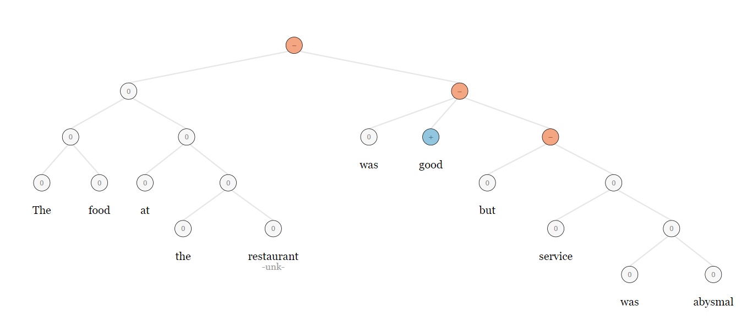
Recursive Neural Networks: Main Idea
Input Text : The food at the restaurant was good but service was abysmal
Output tree :
http://nlp.stanford.edu:8080/sentiment/rntnDemo.html

Slide 31
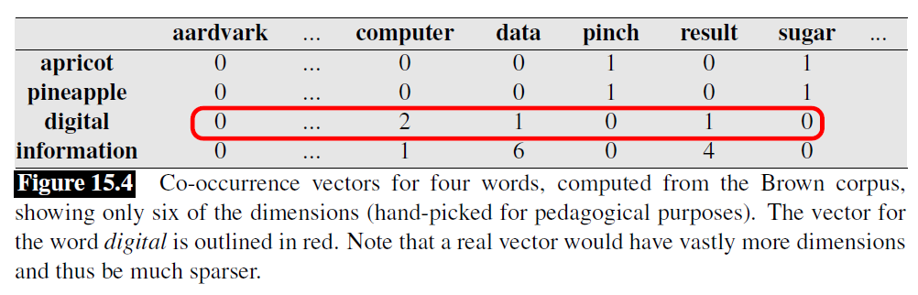
Building Blocks : Word Vectors
Vector space methods ( VSMs) are based on the distributional logic of linguistics : words that occur in similar contexts tend to have similar meanings (Harris, 1954).
Some common VSMs are term-document matrix ( LDA) and term-term matrix ( see below)
- Taken from Stanford NLP website
Apricot and pineapple are more similar to each other than say “ digital” as they seem to have the same context

Slide 32
Building Blocks: Compositionality
The meaning of a complex expression is fully determined by its structure and the meanings of its constituents—once we fix what the parts mean and how they are put together we have no more leeway regarding the meaning of the whole. This is the principle of compositionality, a fundamental presupposition of most contemporary work in semantics – Stanford NLP website
+2
Final sentiment
+ 2
0
0
+ 0
+ 1
0
0
is
The
very
good
boy
POS : Verb
Role : connector
POS : Article
Role : Qualifier
POS : Adverb
Role : exaggerates whatever it precedes
POS : Noun
Role : The subject
POS : Adjective
means =“ positive, nice ”

Slide 33
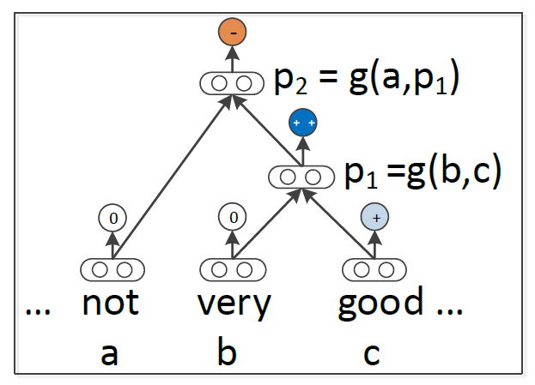
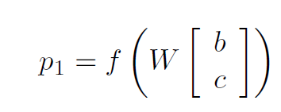
Standard Recursive Neural Networks
RNN are neural networks where every leaf node is an input ( Socher et al 2013)
The input is in the form of a word vector and multiple word vectors are combined using a compositionality function to form a parent node
Compositionality function
classifier
This becomes i/p for next layer
Input layer
Output layer
Hidden layer

Slide 34
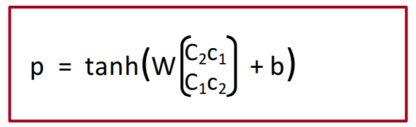
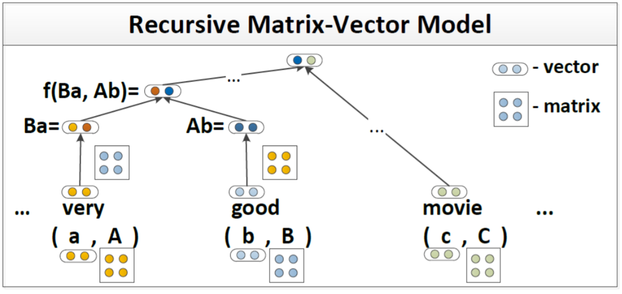
RNTN Predecessors : MV RNN
Notes:
The main idea of the MV-RNN (Socher et al., 2012) is to represent every word and longer phrase in a parse tree as both a vector and a matrix : the vector captures the inherent meaning of the constituent, while the matrix captures how it changes the meaning of neighboring words or phrases
For e.g. “ very good”-> very is an amplifier , “ not good” -> not is a sentiment shifter

Slide 35
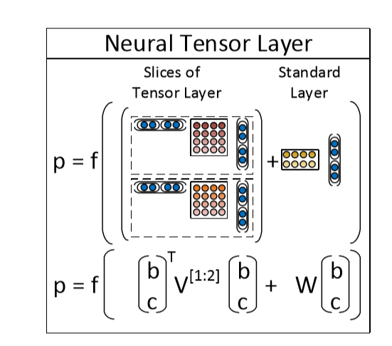
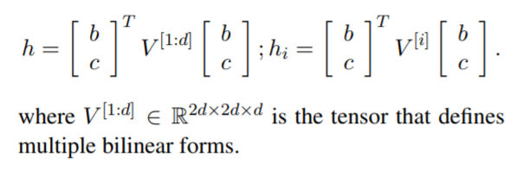
Recursive Neural Tensor Network
The problem with MV- RNN is that the number of parameters becomes very large as there is composition function for every word
The idea of RNTN is to have a single powerful composition function- a tensor based function
Notes:
The main advantage over the previous RNN model, which is a special case of the RNTN when V is set to 0, is that the tensor can directly relate input vectors. Intuitively, we can interpret each slice of the tensor as capturing a speciﬁc type of composition.
Tensors figure prominently in the mathematical underpinnings of general relativity and are fundamental to other branches of physics as well. Tensors are represented internally as multi dimensional arrays

Slide 36
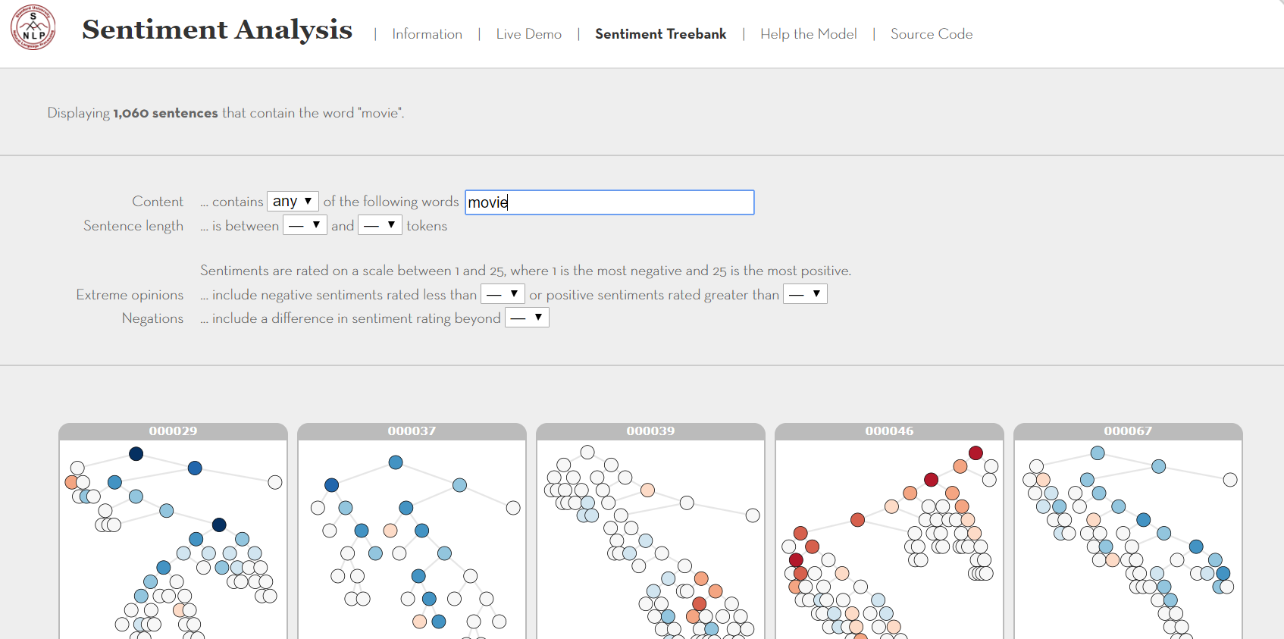
Success Recipe: A SPECIAL DATASET
The corpus is based on the dataset introduced by Pang and Lee (2005) and consists of 11,855 single sentences extracted from movie reviews
It includes a total of 215,154 unique phrases from the review sentences, each annotated by 3 human judges
Snapshot of Stanford Sentiment Treebank
Sample Data :
Phrase ID | Phrase | Sentiment
1 | Bloody cunning | -1
2 | Pleasant experience | +1
3 | The movie had some innocent moments | +1
4 | This is an example | 0
https://nlp.stanford.edu/sentiment/treebank.html?we=OR

Slide 37
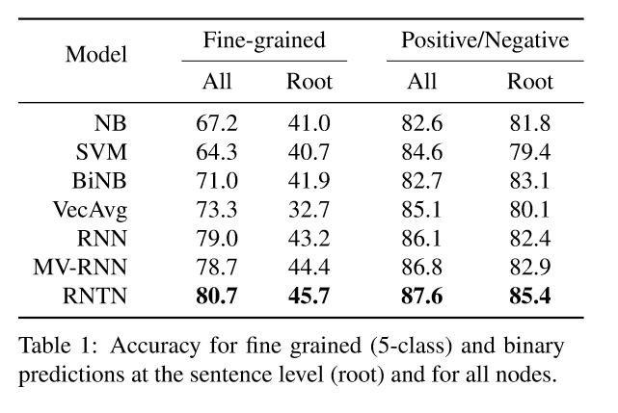
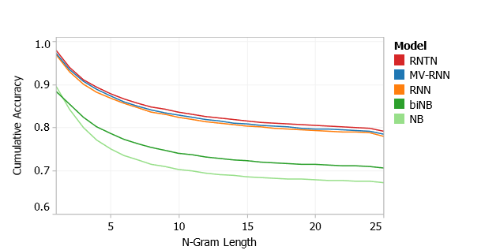
RNTN paper : Results
The recursive models work very well on shorter phrases, while bag of features baselines perform well only with longer sentences
The improvement at root level i.e. sentence –level , however, is not that big as compared to other simpler models

Slide 38
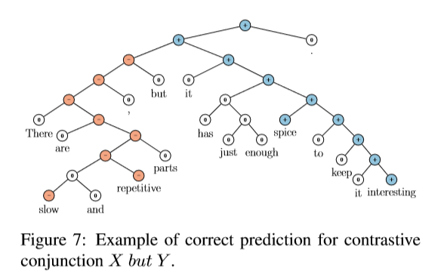
Results : Contrastive Conjunction
Model | Accuracy
RNTN | 41%
MV-RNN | 37%
RNN | 36%
biNB | 27%

Slide 39
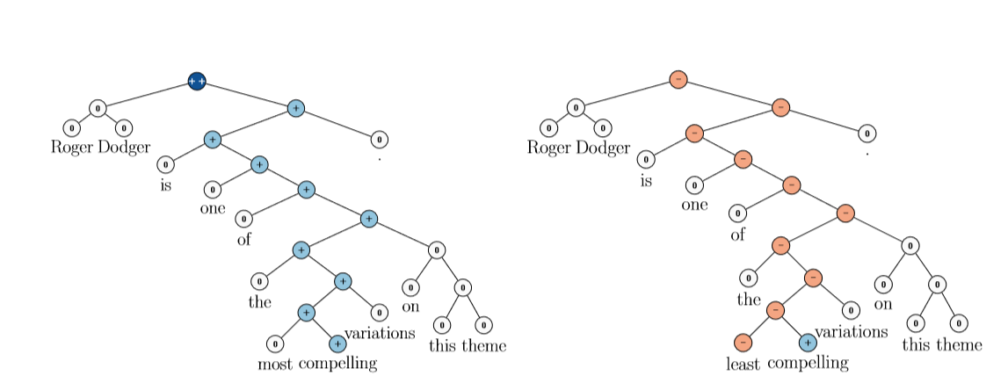
RNTN : Detecting Negations of Positive Sentences
Notes:
Test : The test data comprises of positive sentences and their negation. Negation changes the overall sentiment of a sentence from positive to negative. They compute accuracy in terms of correct sentiment reversal from positive to negative. Fig. 9 shows two examples of positive negation the RNTN correctly classified and RNTN outperforms the other models

Slide 40
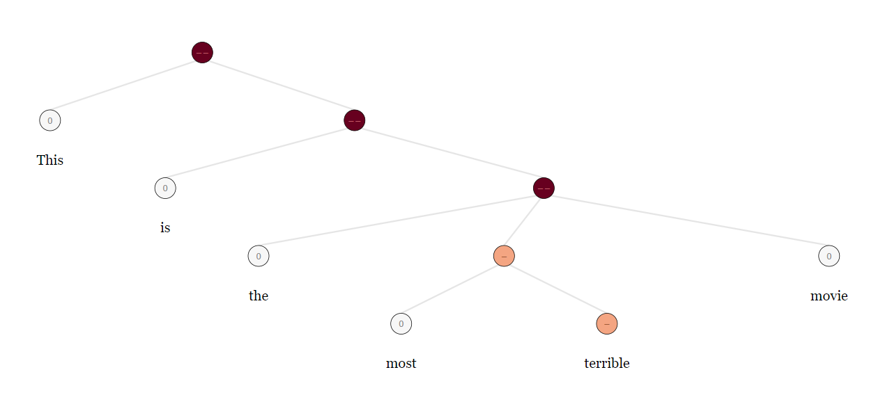
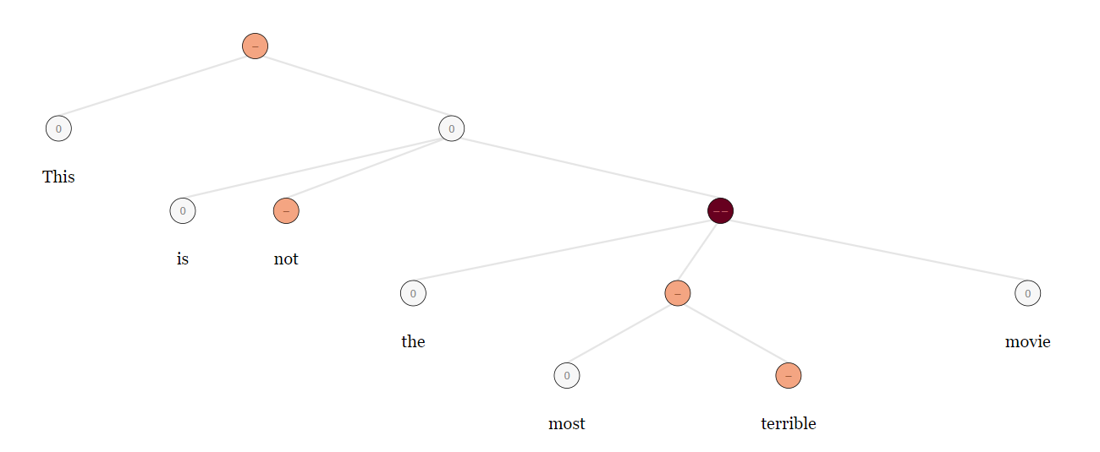
RNTN : Detecting Negations of Negative Sentences
Notes:
This is harder as negations of negative sentences might not always be positive , just less negative

Slide 41
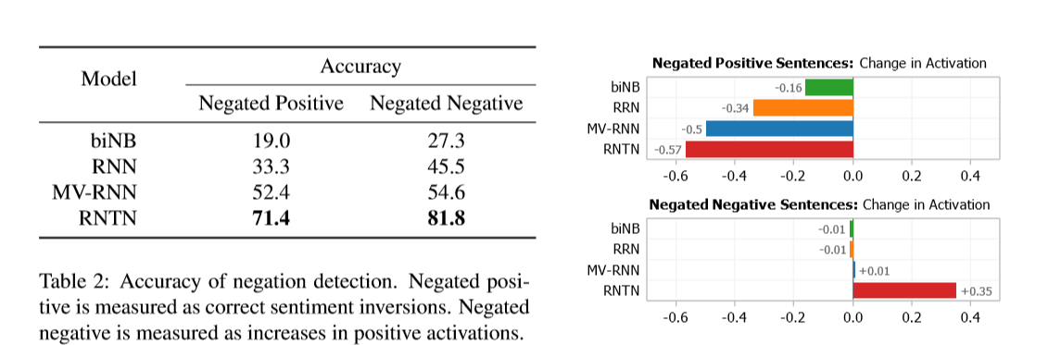
Comparison of different Models

Slide 42
SemEval Task 5 : Aspect Based Sentiment Analysis

Slide 43
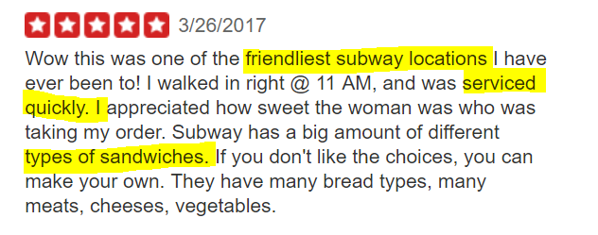
ASPECT LEVEL SENTIMENT ANALYSIS
Input
Step 1 : Identify aspects or topics and words that form an aspect
Step 2 : Use this aspect list to identify which parts of a document refer to a certain aspect
Step 3: Find local polarity of that sub document and attach it to the aspect
Step 4: Summarize aspect level sentiment by aggregating sentiments of all sub documents that mention that aspect
Output
Attribute | Rating
Food | 4
Service | 3
Ambience | 2
Location | 4
Other | 3

Slide 44
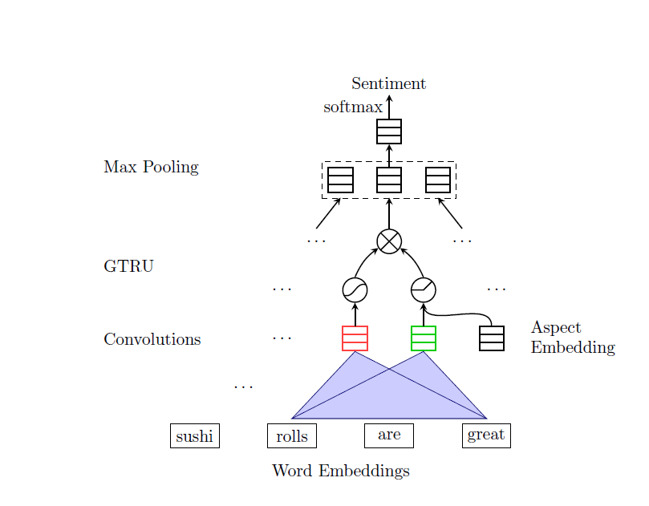
Gated CNN Architecture
A pair of convolutional neuron computes features for a pair of gates: tanh gate and ReLU gate
The ReLU gate receives the given aspect information to control the propagation of sentiment features
The outputs of two gates are element-wise multiplied for the max pooling layer

Slide 45
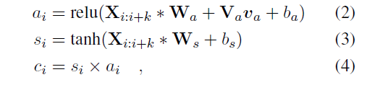
Gated CNN Architecture
va is the embedding vector of a given aspect
Si is similar to the o/p of the vanilla CNN
The model is trained by minimizing the cross entropy loss
Notes:
where va is the embedding vector of the given aspect category in ACSA or computed by another CNN over aspect terms in ATSA. The two convolutions
in Equation 2 and 3 are the same as the convolution in the vanilla CNN, but the convolutional features ai receives additional aspect information
va with ReLU activation function. The proposed Gated Tanh-ReLU Units control the path through which the sentiment information flows towards the pooling layer. The gating mechanisms have proven to be effective in LSTM. In aspect based sentiment analysis, it is very common that different aspects with different sentiments appear in one sentence. The ReLU gate in Equation 2 does not have upper bound on positive inputs but strictly zero on negative inputs. Therefore, it can output a similarity score according to the relevance between the given aspect information va and the aspect feature ai at position t. If this score is zero,the sentiment features si would be blocked at the gate; otherwise, its magnitude would be amplified accordingly. The max-over-time pooling further removes the sentiment features which are not significant over the whole sentence

Slide 46

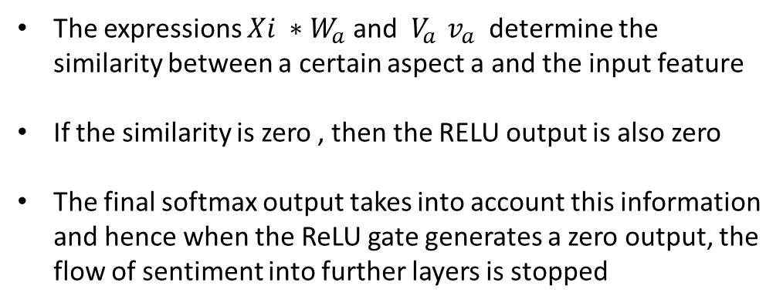
Gated CNN : Intuition

Slide 47
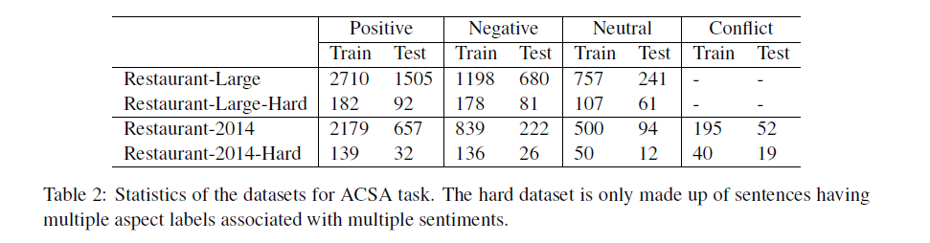
Gated CNN Architecture : Results
The hardest task is to correctly annotate right sentiments to right targets when a sentence has multiple aspects with different sentiments
Hence for model evaluation, they create a hard dataset of restaurant reviews that specifically have more of these types

Slide 48
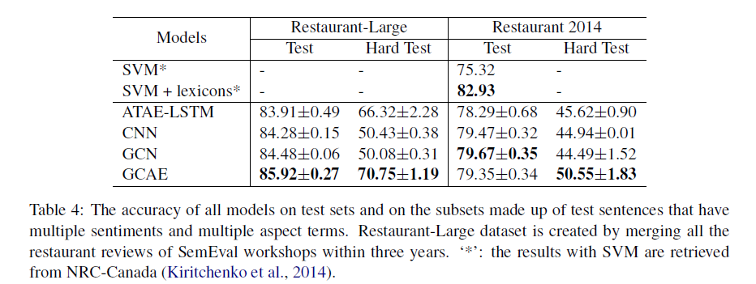
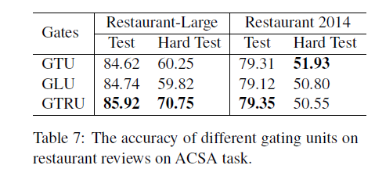
Gated CNN Architecture : Results

Slide 49
Unsupervised Methods

Slide 50

Paper 3 : Generating Reviews & Discovering Sentiment
Top 5 accidental discoveries :
Penicillin
Radio Activity
X Rays
Micro wave
Velcro
Radford et al. were exploring the properties of byte-level recurrent language models, with the goal of predicting the next character in the text of Amazon reviews, when they found that one single neuron in the trained model was highly predictive of the sentiment value.

Slide 51
Training the Model
Task : byte-level recurrent language model to predict the next byte in a review
Amazon product review dataset introduced in McAuley et al. (2015) as a training corpus
82 million reviews from May 1996 to July 2014 amounting to over 38 billion training bytes
Architecture details
Model | Single layer Multiplicative LSTM
No of units | 4096
Mini-batch size | 256
Optimizer | Adam
Training Time | 1 month ( approx.)

Slide 52
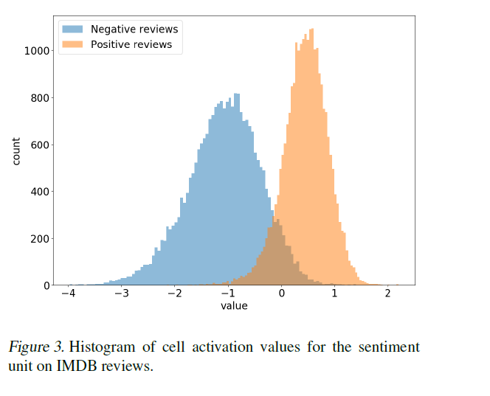
Paper 3 : Generating Reviews & Discovering Sentiment
A single “sentiment neuron” was capable of classifying the reviews as positive or negative, in a pretty accurate way
Accuracy on Stanford Sentiment treebank is 91.8 % which overshoot the earlier best of 90.2%
The other advantage is that it is an unsupervised method so it needs much fewer training examples

Slide 53
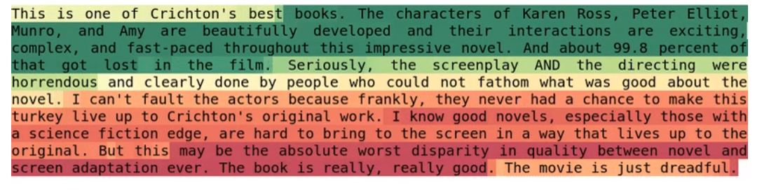
Sentiment Neuron at Work
After the word best, for example, the value of the neuron becomes strongly positive. This effect, however, disappears with the word horrendous
Notes:
Since it’s a byte level model, the sentiment neuron changes value with every character

Slide 54
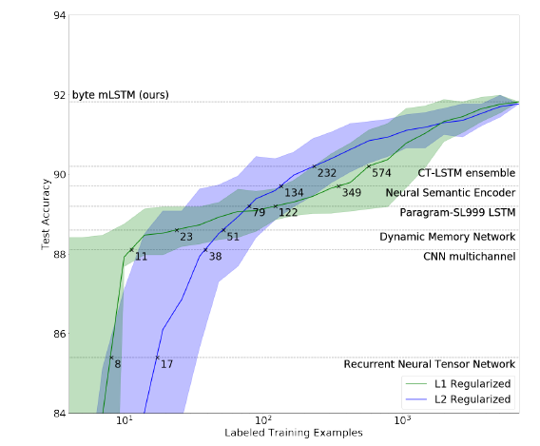
Sentiment Neuron at Work
On the Yelp dataset, the sentiment neuron alone achieves classification accuracy of 91.8 % ( lower than supervised baseline)
The full unit achieves an accuracy of 92.88% which is a very small unit over the sentiment neuron
Thus, the sentiment neuron single handedly can separate reviews into positive and negative
Notes:
Figure 2. Performance on the binary version of SST as a function of labeled training examples. The solid lines indicate the average
of 100 runs while the sharded regions indicate the 10th and 90th percentiles. Previous results on the dataset are plotted as
dashed lines with the numbers indicating the amount of examples required for logistic regression on the byte mLSTM representation
to match their performance. RNTN (Socher et al., 2013) CNN (Kim, 2014) DMN (Kumar et al., 2015) LSTM (Wieting
et al., 2015) NSE (Munkhdalai & Yu, 2016) CT-LSTM (Lookset al., 2017)

Slide 55
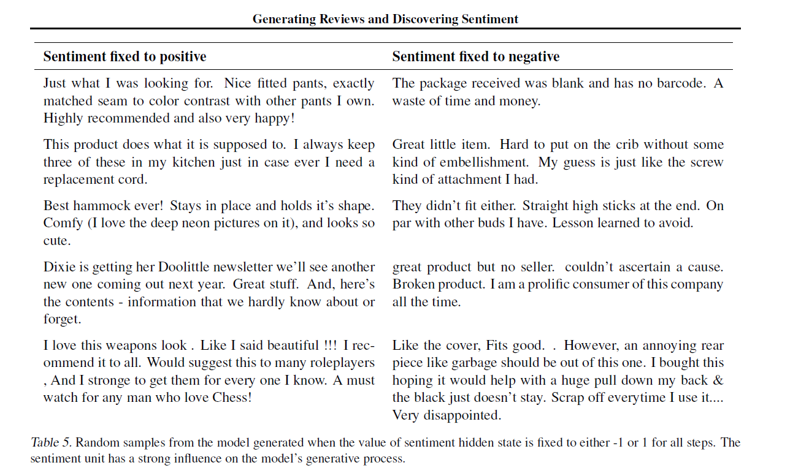
Impact of the sentiment neuron on generation

Slide 56
Applications of Sentiment Analysis

Slide 57
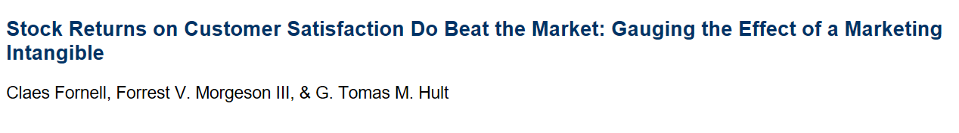
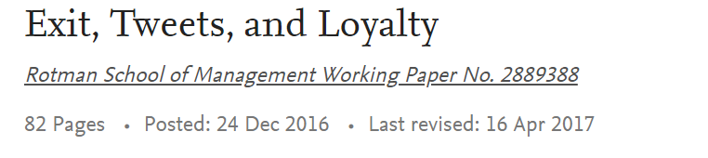
Applications in Business
Main result : Twitter sentiment can predict return on stocks
Main result : Customer tweets on airline delays has a tangible impact on long term loyalty
Notes:
A debate about whether firms with superior customer satisfaction earn superior stock returns has been persistent in the literature. Using 15 years of audited returns, the authors find convincing empirical evidence that stock returns on customer satisfaction do beat the market. The recorded cumulative returns were 518% over the years studied (2000–2014), compared with a 31% increase for the S&P 500.

Slide 58

Applications in Business
NFL’s question- Is online sentiment about teams informative of viewership?
[Source: Nielsen Media Research; 2010-16 NFL regular seasons through Week 8; Live+ Same Day, nationally-televised broadcasts only (CBS, FOX, NBC, ESPN – Excluding NFL Network)]
Notes:
We found that lagged sentiments leading up to a match have good predictive power for viewership especially for teams that have mixed probabilities of winning

Slide 59


Applications in Politics

Slide 60
Questions for Discussion
1.The SOTA for Fine-grained sentiment analysis for full sentence level is still at 53 % and this is the result from a hugely studied dataset so it might be even lower for other generic datasets. What could be a fundamental issue with fine-grained sentiment classification? Are even humans really able to do this task well?
2.Is a particular neural network more suited for sentiment analysis? Several architectures seem to be giving similar or just marginally different results
3.Sentiment Analysis research has been extended to analyze emotions . Are there are specific challenges in emotion analysis or is it just a more fine-grained sentiment analysis problem?
4.In sentiment analysis and opinion mining research, not a lot of attention has been paid to the person whose sentiment we are measuring. Is homogeneity a very strong assumption? Some people might be using stronger words than others to convey same extent of sentiment

Slide 61
More Reference Material
https://www.cs.uic.edu/~liub/FBS/Sentiment-Analysis-tutorial-AAAI-2011.pdf
http://www.saifmohammad.com/WebDocs/EMNLP2014-SentimentTutorial.pdf
https://building.lang.ai/understanding-what-is-behind-sentiment-analysis-part-i-eaf1bcb43d2d
https://www.aclweb.org/mirror/emnlp2016/tutorials/zhang-vo-t4.pdf
http://confusedlanguagetech.blogspot.com/2012/07/jordan-boyd-graber-and-philip-resnik.html
https://www.learndatasci.com/tutorials/predicting-reddit-news-sentiment-naive-bayes-text-classifiers/

Slide 62


